Slide 1
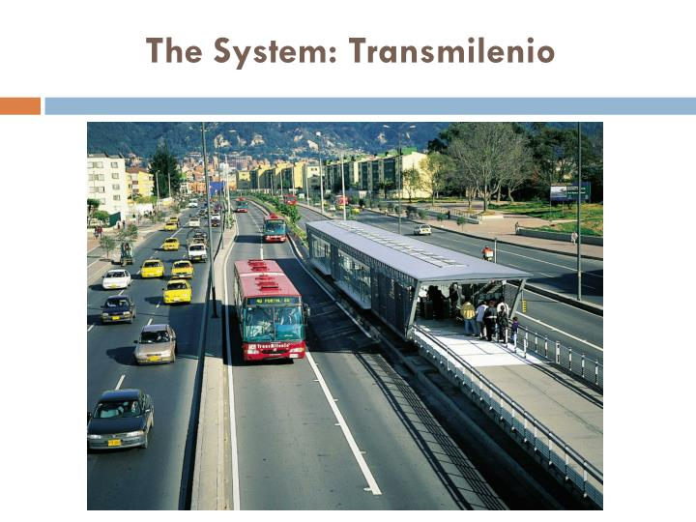
PUBLIC TRANSPORT OPTIMIZATION
IOT_PHASE4: DEVELOPMENT PART2

Slide 2
INTRODUCTION:
Improved public transport integration can bring benefits to both public transport users
and public transport providers.
Public transport refers to shared passenger transportation services like bus, trains,
metro, trolleybus etc.
First, it can provide passengers with a better travel experience by making it easier
and more convenient to use, especially in competition with private modes such as
motorbikes, cars and taxis. Second, effective public transport system integration can
enhance public transport’s financialsustainability by decreasing overall costs through
reduced overlap and redundancy and increasing revenue by attracting more customers.

Slide 3
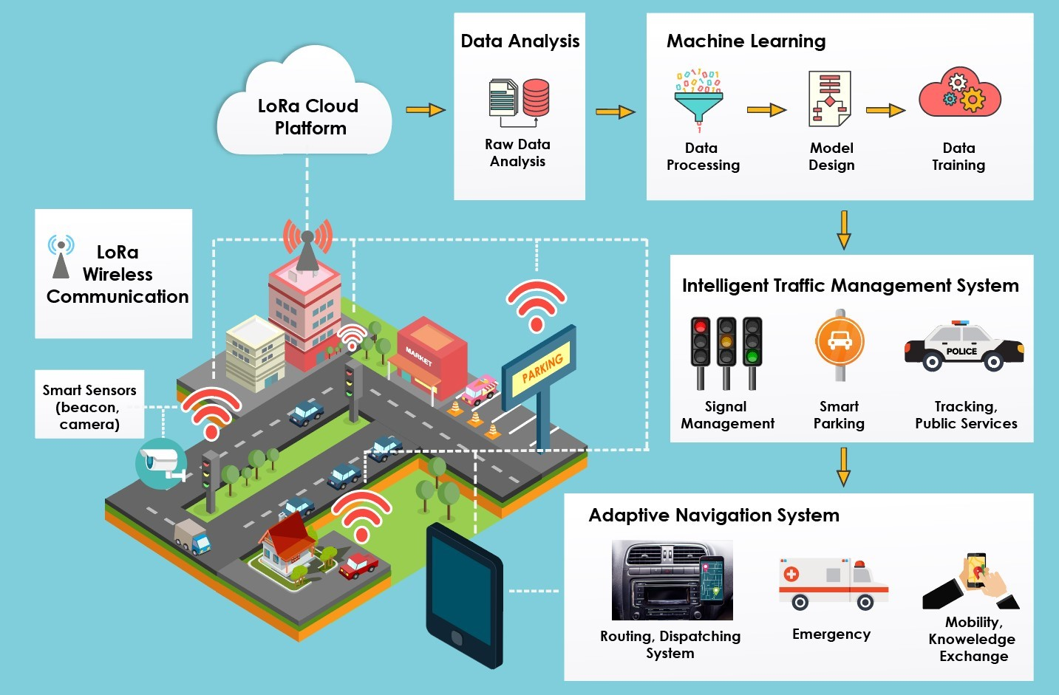
Optimization of public transportation network :

Slide 4

Components:
ESP 32
Ultrasonic distance sensor
LED
wires

Slide 5
PROGRAM:
#include <WiFi.h>
#include <ThingSpeak.h>
const char* ssid = "Wokwi-GUEST"; // Replace with your Wi-Fi SSID
const char* password = ""; // Replace with your Wi-Fi password
const unsigned long channelID = 2314735; // Your ThingSpeak Channel ID
const char* apiKey = "ET0D4BTO8GFP64IR"; // Your ThingSpeak Write API Key
const unsigned long updateInterval = 60000; // Update interval in milliseconds (1 minute)
const int irSensor1 = 13;
const int irSensor2 = 14;
int passengerCount = 0;
int sensor1State = 0;
int sensor2State = 0;
int lastSensor1State = 0;
int lastSensor2State = 0;
unsigned long lastConnectionTime = 0;

Slide 6
WiFiClient client;
void setup() {
Serial.begin(115200);
WiFi.begin(ssid, password);
ThingSpeak.begin(client);
pinMode(irSensor1, INPUT);
pinMode(irSensor2, INPUT);
}
void loop() {
sensor1State = digitalRead(irSensor1);
sensor2State = digitalRead(irSensor2);
if (sensor1State != lastSensor1State) {
if (sensor1State == HIGH) {
passengerCount++;
Serial.println("Passenger count increased: " + String(passengerCount));
}
lastSensor1State = sensor1State;
}

Slide 7
if (sensor2State != lastSensor2State) {
if (sensor2State == HIGH) {
passengerCount--;
Serial.println("Passenger count decreased: " + String(passengerCount));
}
lastSensor2State = sensor2State;
}
if (millis() - lastConnectionTime > updateInterval) {
updateThingSpeak();
}
}
void updateThingSpeak() {
ThingSpeak.setField(1, passengerCount);
int httpCode = ThingSpeak.writeFields(channelID, apiKey);
if (httpCode == 200) {
Serial.println("Data sent to ThingSpeak successfully");
} else {
Serial.println("Failed to send data to ThingSpeak");
}
lastConnectionTime = millis();
}

Slide 8
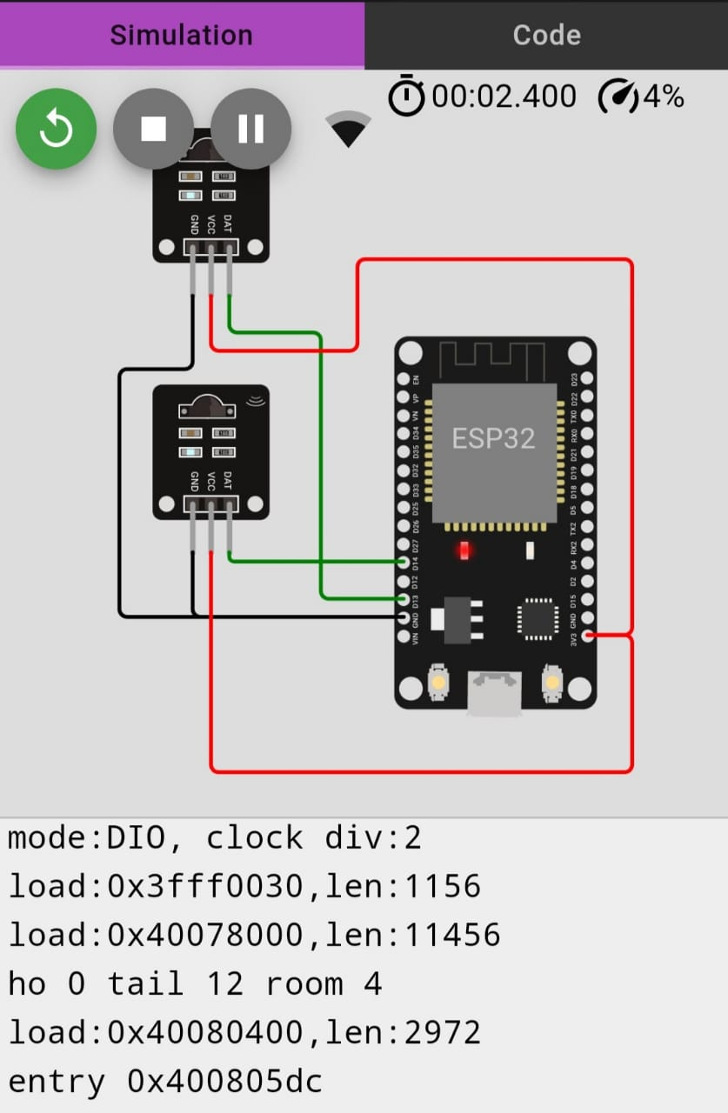
OUTPUT:

Slide 9
Components:
Arduino uno servo
Potentiometer
Breadboard
Resistor
LCD 16*2
PIR sensor

Slide 10
PROGRAM:
import 'package:flutter/material.dart';
import 'package:http/http.dart' as http;
import 'dart:convert';
void main() => runApp(MyApp());
class MyApp extends StatelessWidget {
Widget build(BuildContext context) {
return MaterialApp(
home: VehicleLocations(),
);
}
}
class VehicleLocations extends StatefulWidget {
_VehicleLocationsState createState() => _VehicleLocationsState();
}

Slide 11
class _VehicleLocationsState extends State<VehicleLocations> {
String locationData = "";
Future<void> fetchVehicleLocations() async {
final response = await http.get('http://your-python-server-url/get_vehicle_location?vehicle_id=bus1');
if (response.statusCode == 200) {
setState(() {
locationData = json.decode(response.body).toString();
});
}
}
Widget build(BuildContext context) {
return Scaffold(
appBar: AppBar(
title: Text('Public Transport Optimization App'),
),

Slide 12
body: Center(
child: Column(
children: <Widget>[
ElevatedButton(
onPressed: fetchVehicleLocations,
child: Text('Get Vehicle Location'),
),
Text(locationData),
],
),
),
);
}
}

Slide 13
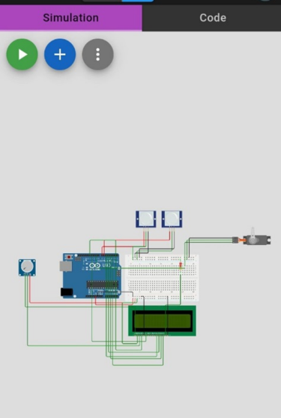
OUTPUT:

Slide 14
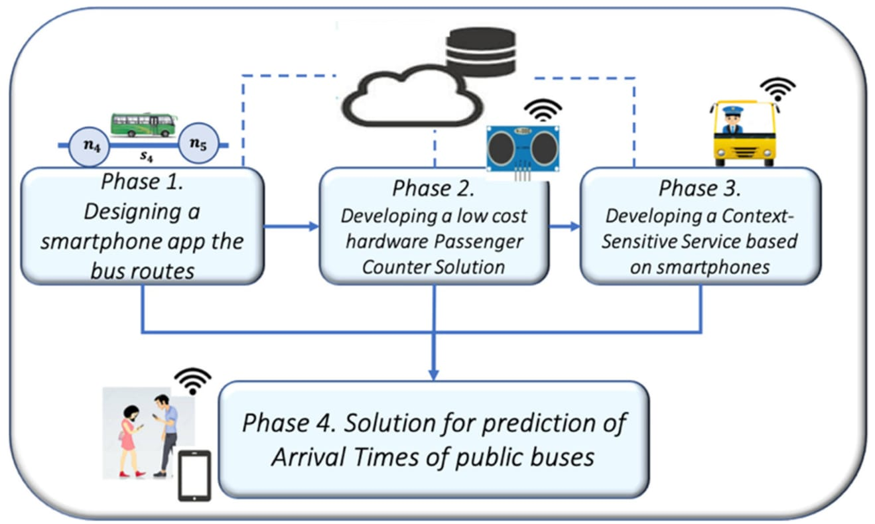
A smart information system for public transport optimization :

Slide 15
FEATURES :
Public transportation is a form of local travel that enables more people to commute
together along designated routes.
Typical examples of types of public transportation include buses, airlines and coaches.
IOT provides real-time monitoring, which allows users to track their booked buses.
Help streamline the storage of goods and managemen of inventory levels.

Slide 16
THANK YOU...
PRESENTED BY :
Pradeep. R
422621104032
University College Of Engineering, Panruti.

